Slide 1

Design Masterclass Group 1
Design Masterclass.
Ubisoft.
Samuel Cook: Game Design & Art.
William Terry: Programming.

Slide 2

Types of Players.

Slide 3
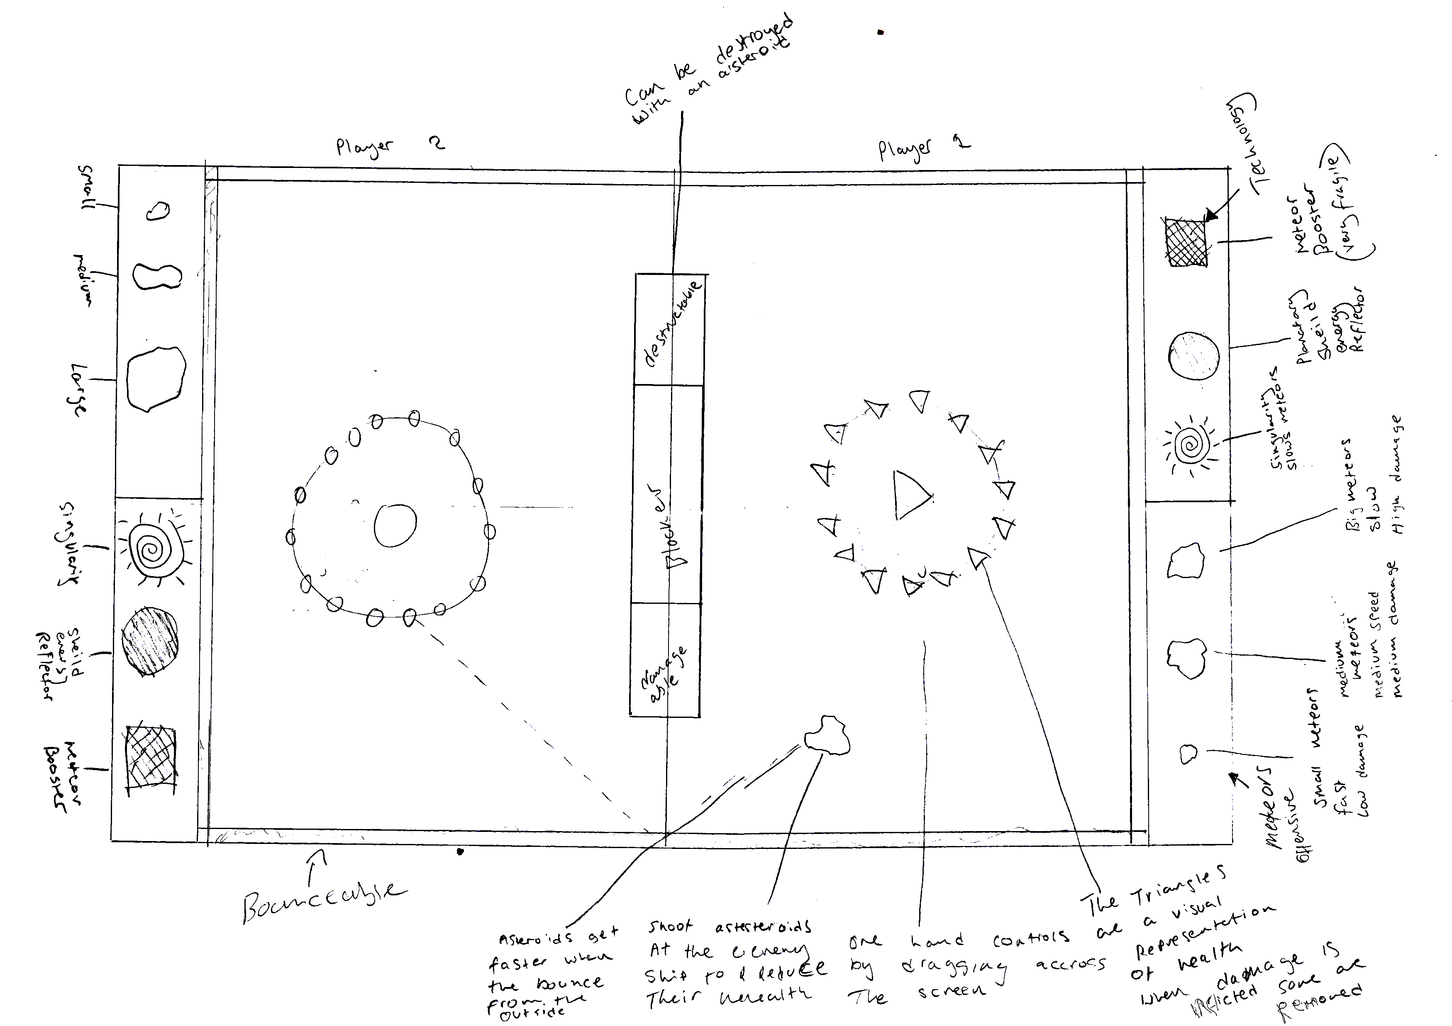
Elements we wanted in our Game
Trial and Error.
Simple Controls.
Simultaneous play.
Bouncing/Richochet.

Slide 4
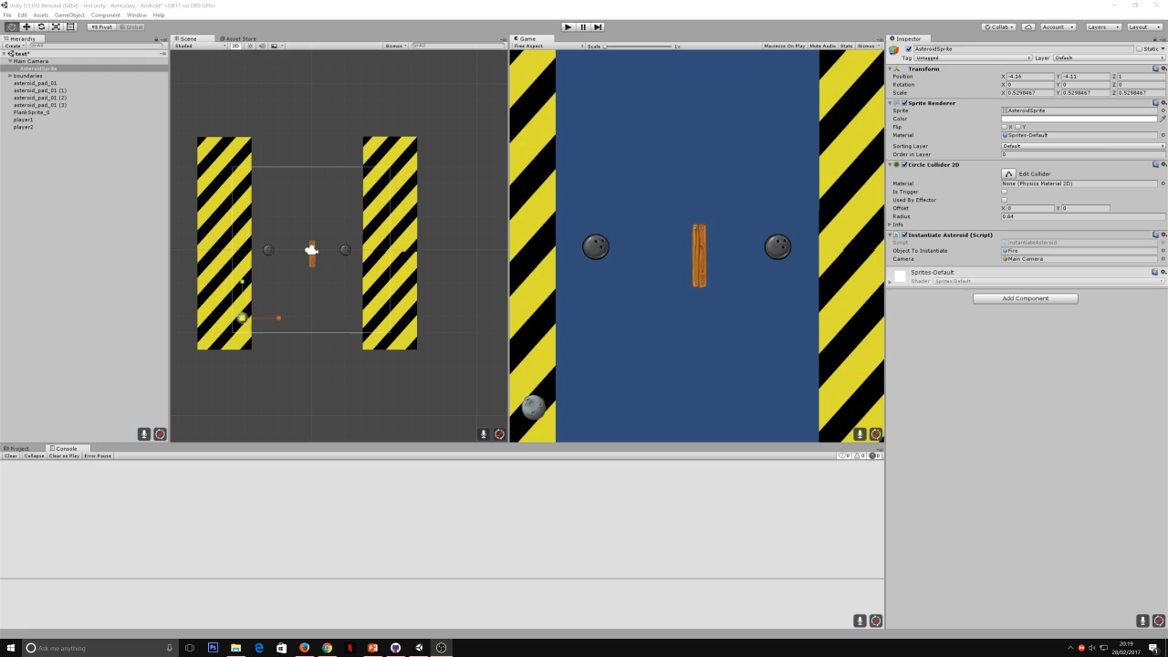
Prototyping

Slide 5
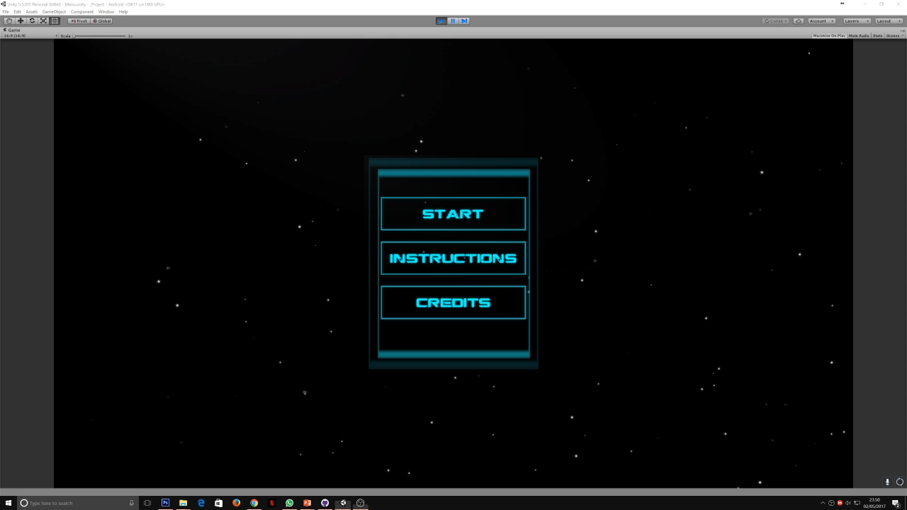
Game Play

Slide 6
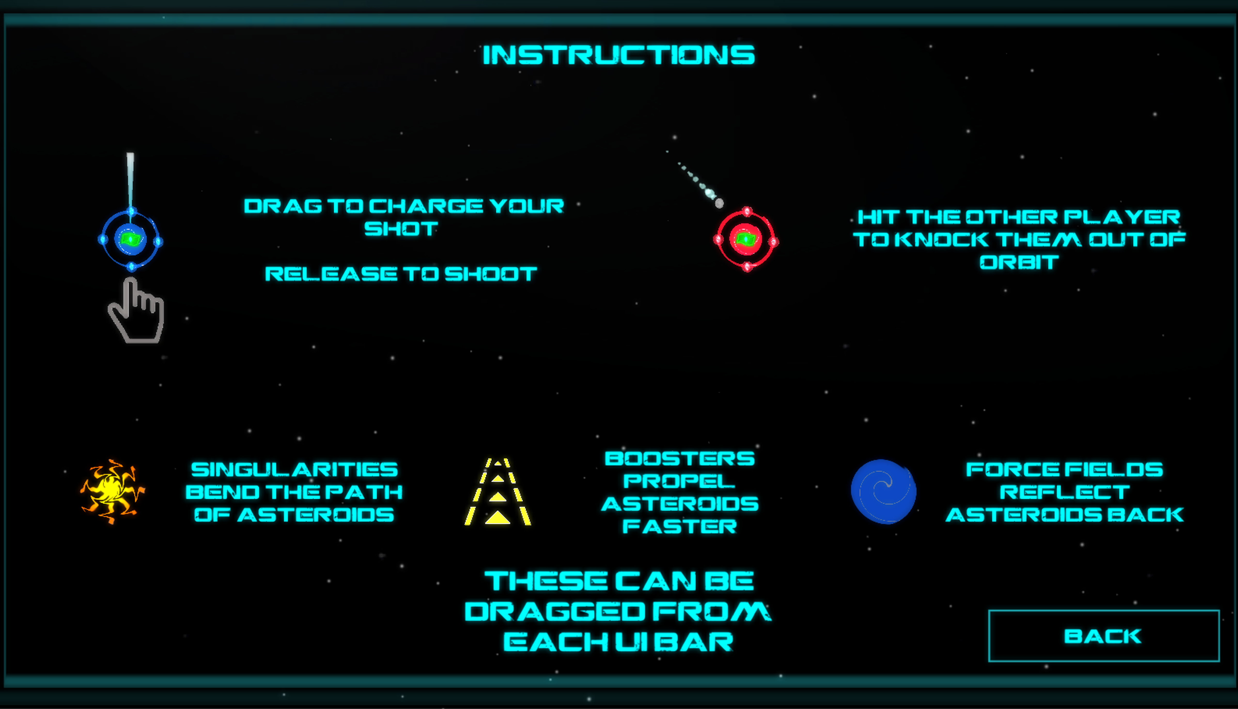
Player Instructions.

Slide 7
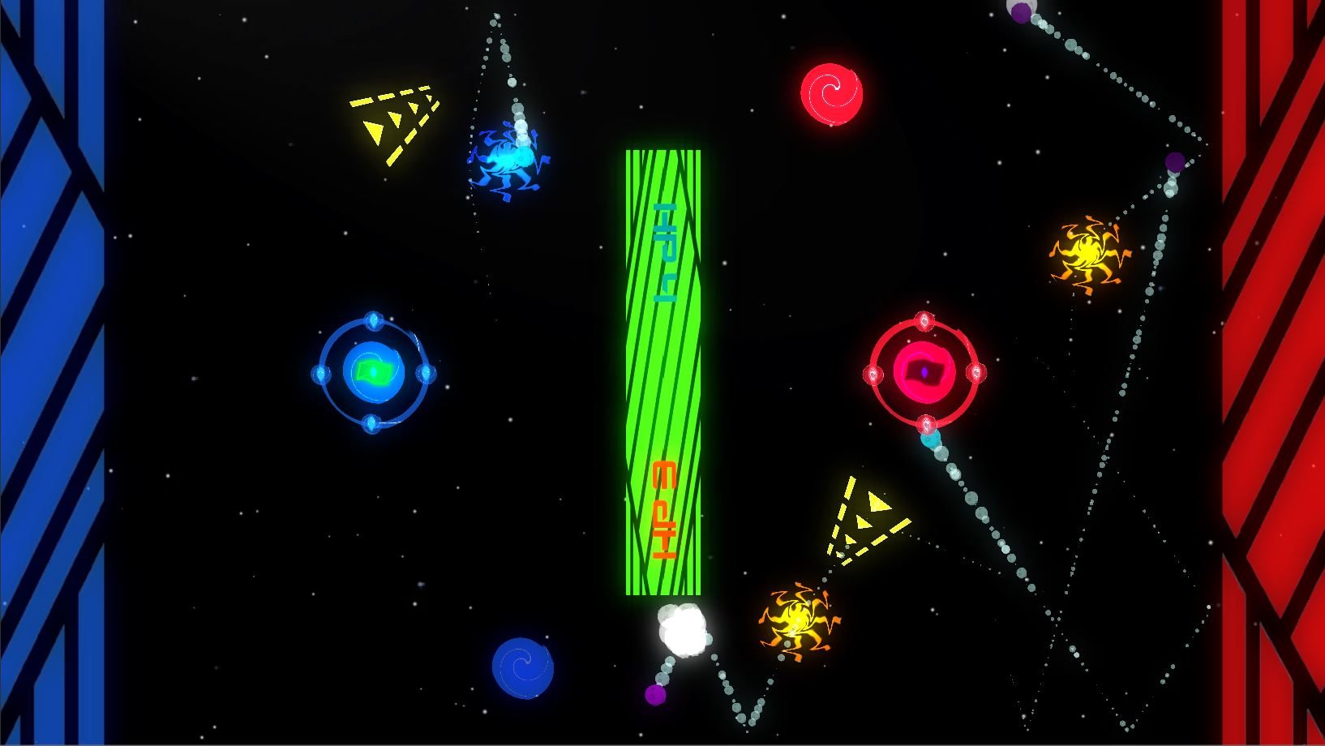


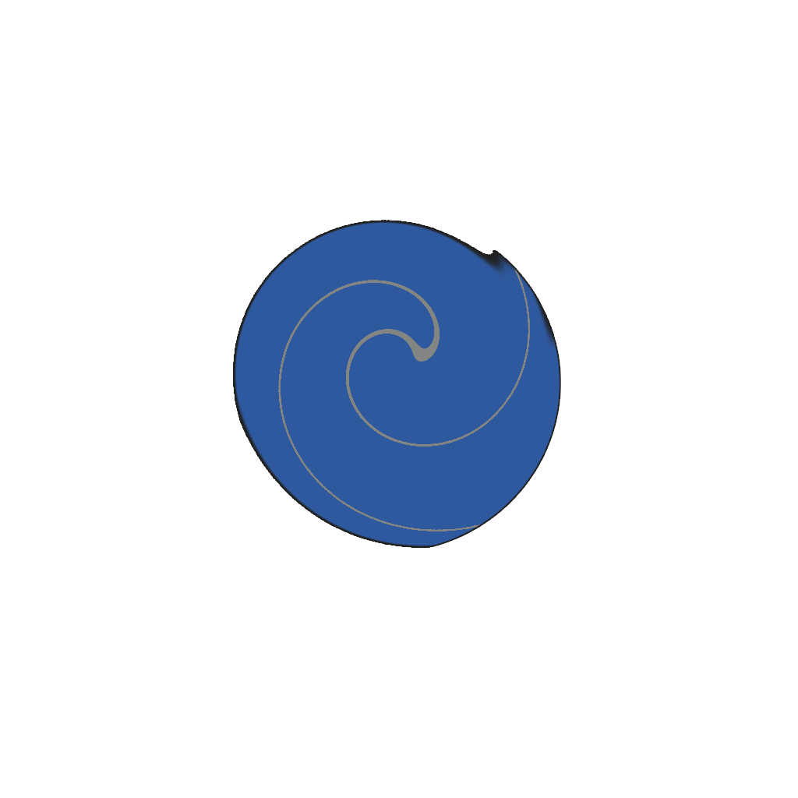
Player Actions.

Slide 8
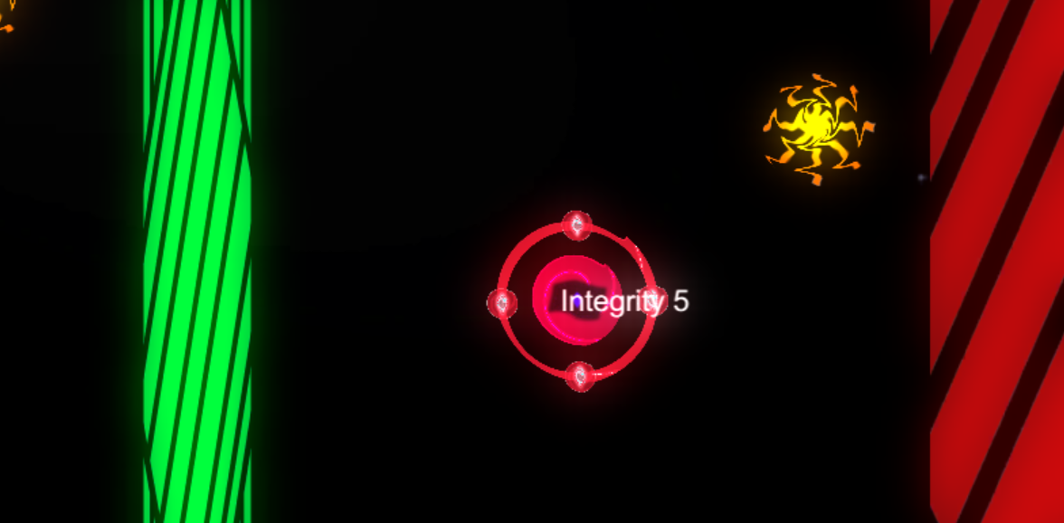
Purchasable Items
Items can be bought with points earned by hitting the other player’s base
Player will drag them from their shop to the play area

Slide 9
Component Breakdown
Boosters can be placed in the game to speed up projectiles that fly through them.
Forcefields can be placed to block enemy projectiles reflecting them back the direction they came.
Singularities can be placed to block enemy asteroids and cause them to spin away randomly.

Slide 10
Design Deviations
Initially we had had the projectiles as a purchasable from the UI bar however this proved to be too many actions for the player to take at once as they also had to move the player at the same time
We made the player static and made the asteroids always shoot from the players location.
The game initially ran constantly until one player ran out of health, now all projectiles and purchasables are destroyed when damage is inflicted, essentially splitting the game into rounds and allowing the player a few seconds to form new strategies or shore up defences.

Slide 11
Steps to take
Polish Shooting (Touch input handling)
Matching projectile trail colours

Slide 12
Questions?

